Slide 1
LU-Decomposition

Slide 2
Contents of the presentation
01
02
03
LU
Decomposition
Mathematical View
Time Comparison

Slide 3
LU - Decomposition
01

Slide 4
What is LU Decomposition?
It is introduced in 1938.
LU decomposition is a specific type of matrix factorization, there is other factorization methods, each with its unique characteristics and applications in numerical computations and problem-solving.
A square matrix is said to have an LU decomposition (or LU factorization) if it can be written as the product of a lower triangular (L) and an upper triangular (U) matrix.

Slide 5
01
Simplifies solving systems of linear equations.
Why LU Decomposition?
02
Facilitates numerical stability in matrix computations.
03
Helps in Signal Processing, Image Processing, and Control Systems

Slide 6
02
Mathematical View

Slide 7
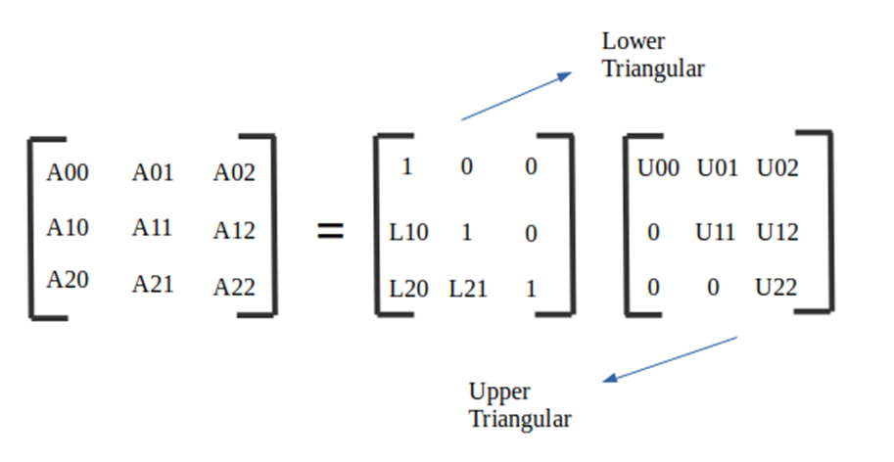
Assume→
[A]= Original matrix
[L]Lower triangular matrix.
[U] Upper triangular matrix
[A] = [L][U]

Slide 8
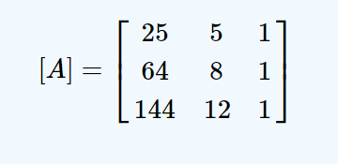
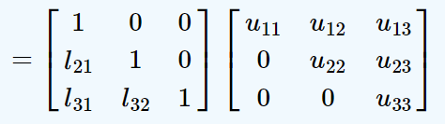
Lu-Decomposition Example
→
→

Slide 9
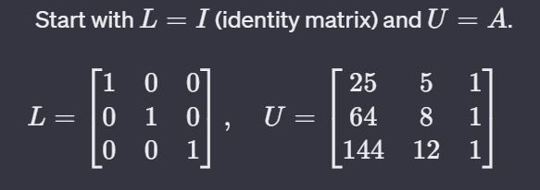
Lu-Decomposition Example (cont)
Initialize L and U:

Slide 10
Lu-Decomposition Example (cont)
2. Perform row operation :
Row operations play a crucial role in the process of LU decomposition.
The basic idea is to perform a sequence of elementary row operations on the original matrix until it is transformed into the product of L and U.Where it becomes between the row and the first row until the previous row.
The three elementary row operations are:
A. Interchanging (or swapping) two rows.
B. Multiplying a row by a nonzero scalar.
C. Adding or subtracting a multiple of one row from another.

Slide 11

Lu-Decomposition Example (cont)
3. In each step of the decomposition, we perform row operations on the original matrix, but the first element of the first row in all columns remains the same.So,R1 is still 25 5 1 in U matrix and 1 0 0 in L matrix.

Slide 12
Lu-Decomposition Example (cont)
4. Perform row operations on R2.
A. Interchanging (or swapping) two rows start from R1 to previous Row → R2 and R1 .
B. Multiplying a row by a nonzero scalar .
How find the scalar ?
In order to be the U matrix has values in upper triangle so R2 in column one should be zero so the scalar will be (value of R2,1 /value of R1,1) =(64/25)
C. Adding or subtracting a multiple of one row from another.

Slide 13

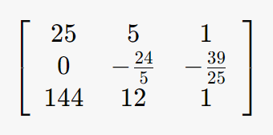
Lu-Decomposition Example (cont)
4(cont)Perform row operations on R2 with R1.
U =

Slide 14
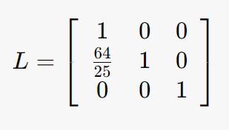
Lu-Decomposition Example (cont)
4(cont) Put the nonzero scalar =(64/25) at R2 first column in L matrix.
Now we should perform row operation on the next row of R1 and previous of R2 but R1 is only previous R2 ,So we will perform it on R3 .

Slide 15
Lu-Decomposition Example (cont)
5. Perform row operations on R3.
A. Interchanging (or swapping) two rows start from R1 to previous Row → R3 and R1 .
B. Multiplying a row by a nonzero scalar .
How find the scalar ?
In order to be the U matrix has values in upper triangle so R3 in column one should be zero so the scalar will be (value of R3,1 /value of R1,1) =(144/25)
C. Adding or subtracting a multiple of one row from another.

Slide 16

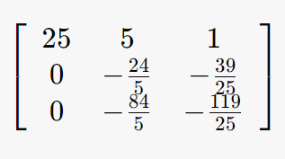
Lu-Decomposition Example (cont)
5(cont)Perform row operations on R3 with R1.
U =

Slide 17
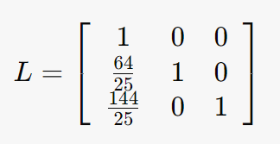
Lu-Decomposition Example (cont)
5.(cont) Put the nonzero scalar =(144/25) at R3 first column in L matrix.
Now we should perform row operation on the next one of R1 and previous of R3 which is R2 ,So we will perform row operations between R2 and R3 .

Slide 18
Lu-Decomposition Example (cont)
6. Perform row operations on R3.
A. Interchanging (or swapping) two rows start from R1 to previous Row → R2 and R3 .
B. Multiplying a row by a nonzero scalar .
How find the scalar ?
In order to be the U matrix has values in upper triangle so R3 in column two should be zero so the scalar will be (value of R3,2 /value of R2,2) =(7/2)
C. Adding or subtracting a multiple of one row from another.

Slide 19

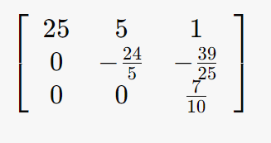
Lu-Decomposition Example (cont)
6. (cont)Perform row operations on R3 with R2.
U =

Slide 20
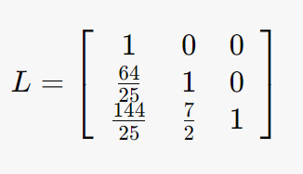
Lu-Decomposition Example (cont)
6. (cont)Put the nonzero scalar =(7/2) at R3 second column in L matrix.
Now we should perform row operation on the next one of R2 and previous of R3 but R2 is the last previous of R3 ,So we done the LU-Decomposition of matrix A.

Slide 21
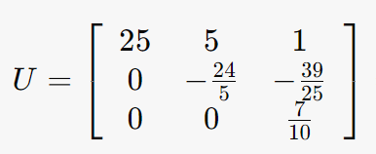
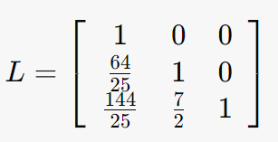
Lu-Decomposition Example (cont)
7. Final result :

Slide 22
03
Time Comparison

Slide 23
Serial Implementation
Matrix Size(N * N) | Time (seconds)
50 | 0.000145
1000 | 1.34
2000 | 12.7
3000 | 50.9

Slide 24
OpenMP Implementation
(4 Threads)
Matrix Size(N * N) | Time (seconds)
50 | 0.0015
1000 | 1.94
2000 | 12.9
3000 | 44.2

Slide 25
OpenMP Implementation
(16 Threads)
Matrix Size(N * N) | Time (seconds)
50 | 0.00203
1000 | 1.69
2000 | 9.75
3000 | 31.9

Slide 26
OpenMP Implementation
(40 Threads)
Matrix Size(N * N) | Time (seconds)
1000 | 1.27
2000 | 8.14
3000 | 22.4

Slide 27
CUDA Implementation
16 Blocks , 250 T/Block
Matrix Size(N * N) | Time (seconds)
50 | 0.14
1000 | 0.502
2000 | 1.9
3000 | 4.41

Slide 28
CUDA Implementation
32 Blocks , 250 T/Block
Matrix Size(N * N) | Time (seconds)
50 | 0.8
1000 | 0.501
2000 | 1.89
3000 | 4.0

Slide 29
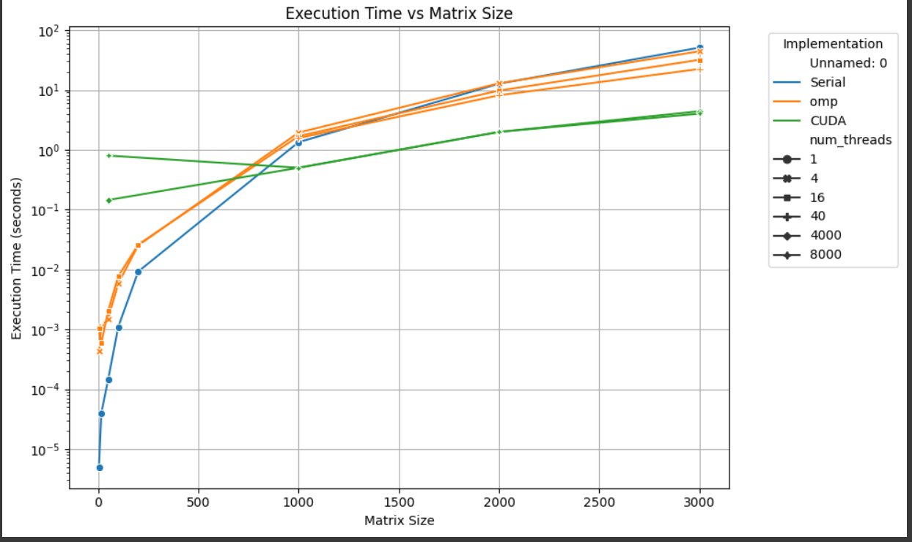

Slide 30
Thank You
Any questions?
Tamara Abu-hawileh Fatima Ghazal
0195922 Sec(Tuesday) 0194433Sec(Thuresday)

